Slide 1






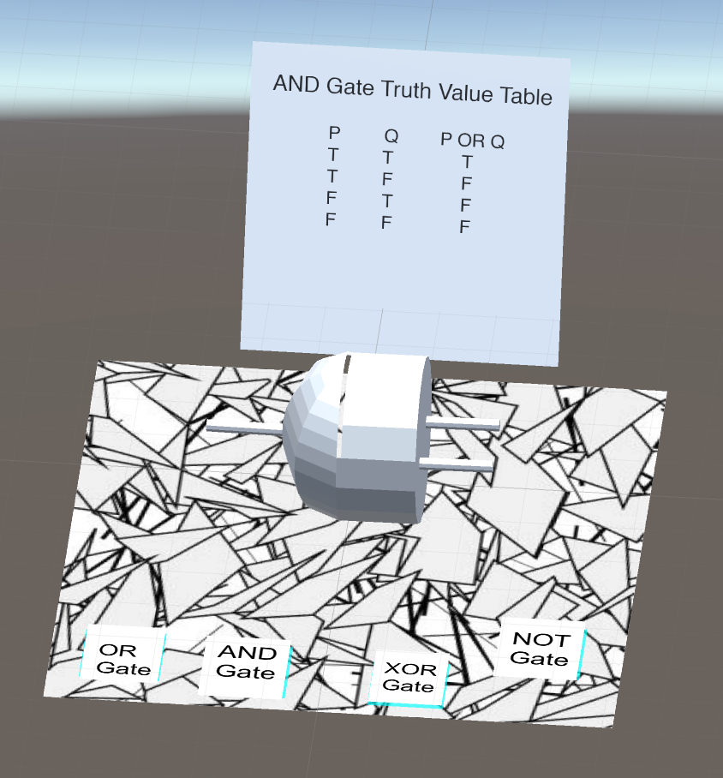
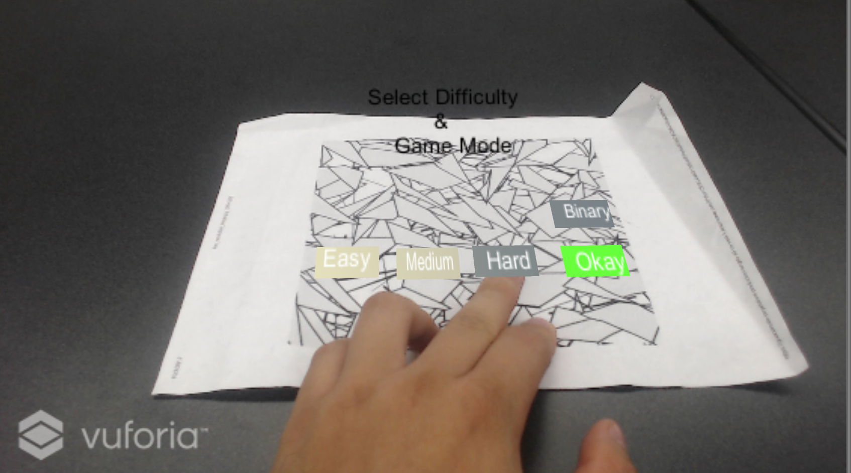
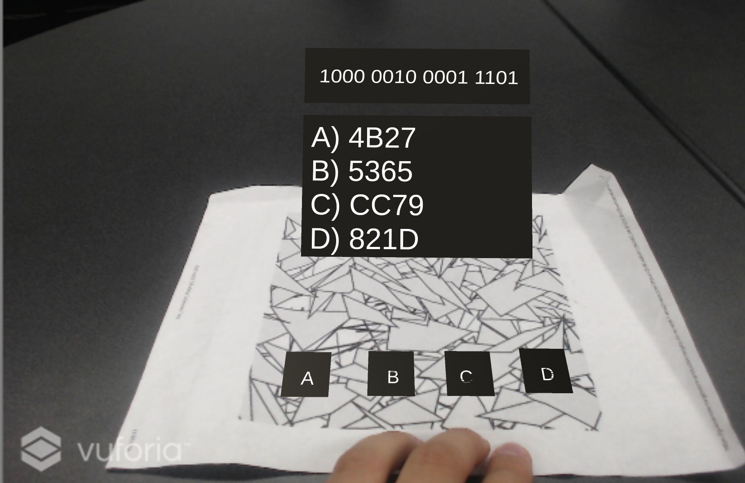
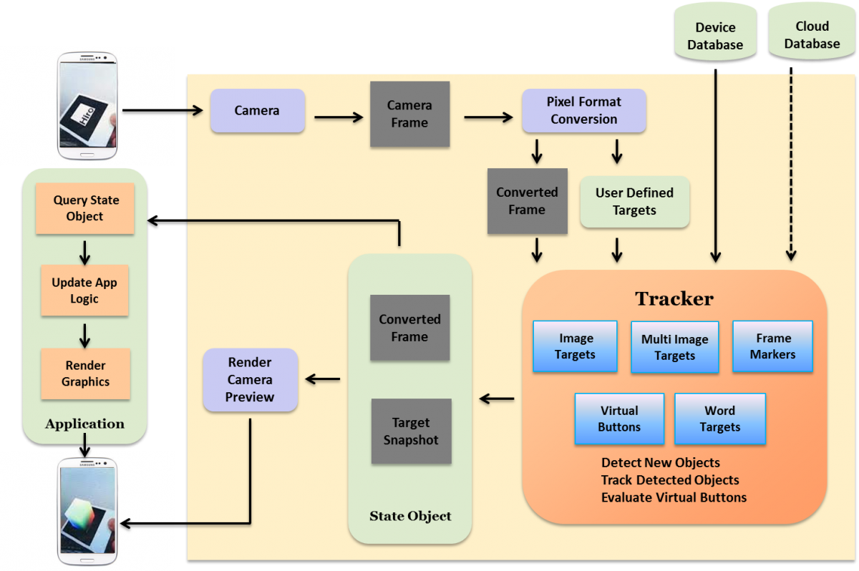
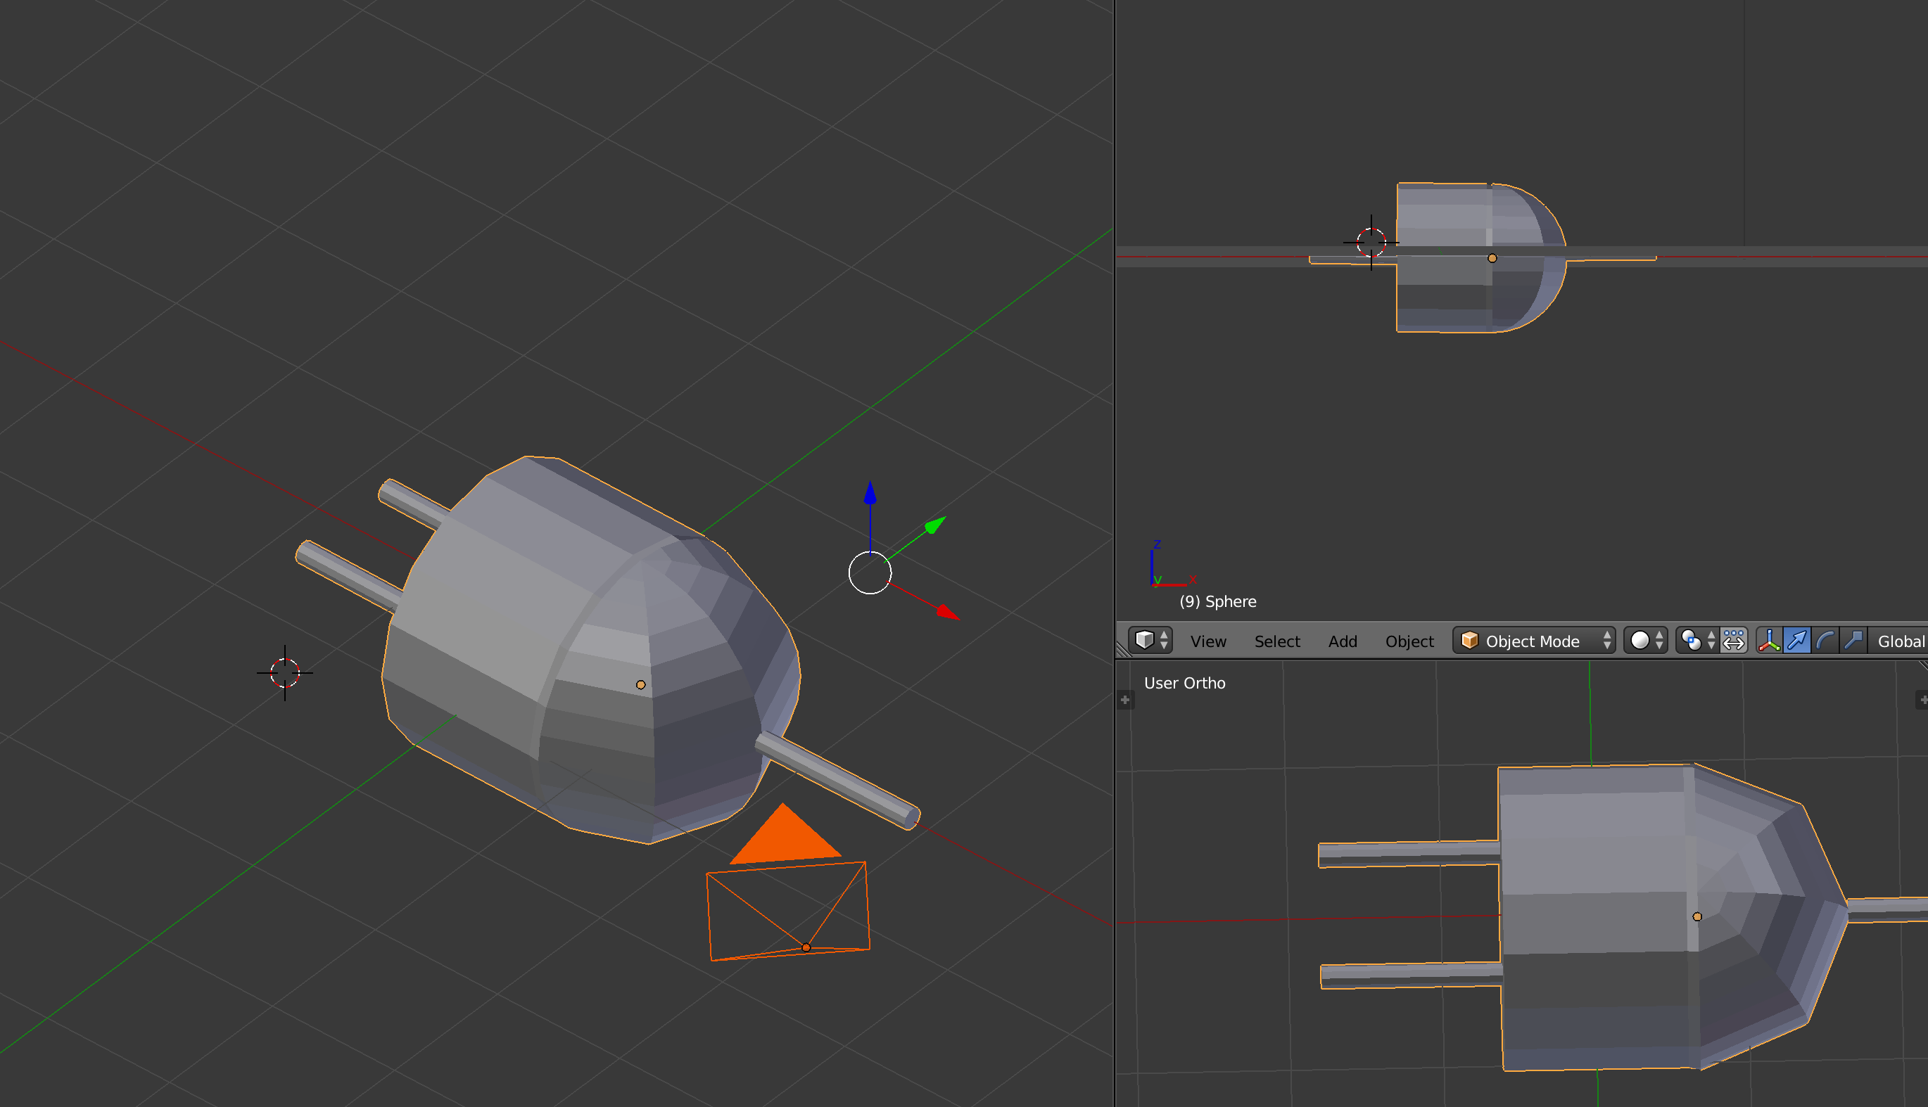
School of Computing & Information Sciences
Senior VIP, 2017, Fall
AR-VR-VE for Computer Science Education 1.0:
ARCSE
Student: Hamilton Chevez, Florida International University
Mentor: Francisco R. Ortega, Florida International University
Instructor: Masoud Sadjadi, Florida International University
Purpose
Increase the retention rate of Computer Science students.
Create a set of educational activities for students to use in Mixed-Reality.
Explore the use of virtual buttons for user interactivity.
Application
The student will use AR/MR as a different medium of learning for CS topics.
Unity with the Vuforia API was used to create a cross-platform solution.
Vuforia permits AR/MR experiences through target-based tracking.
Current System
Through a mobile app menu the user picks which AR/MR activity to do.
The camera device is pointed at the pre-defined AR target.
Through a series of instructions in AR, the user interacts with the system.
Screenshots
AND Gate reference model through Unity’s Scene view.
Binary/Hex Value conversion activity menu
Binary to Hex conversion activity.
Implementation & System Design
Blender was used to create the models for the Logic Gates reference scene.
Vuforia uses a database of user defined image targets that are used by the Tracker for rendering Objects and evaluating Virtual Buttons.
Each frame is checked for obstruction to line of sight to models and virtual buttons, which trigger updates in application logic.
Requirements
Use mobile devices for a Augmented or Mixed Reality experience.
Create visualizations of abstract data structures and algorithms in Augmented Reality.
Create user interactivity with augmented props.
Summary
ARCSE has the potential to enrich material taught in Computer Science courses.
Creating engaging visual learning material, the range of retention can increase for students with difficulty learning from traditional expositional teaching styles.
What’s Next
Create more reference based AR scenes.
Create interactive scenes for learning Algorithms.
Upgrade to Vuforia 7 for Ground Plane feature and remove the need for marker-based tracking.
Create more polished models in Blender.
Acknowledgement
The material presented in this poster is based upon the work supported by Hamilton Chevez. I am thankful to the help that I received from my project mentor Francisco Ortega and group members Francisco Lozada, Filip Klepsa, Lukas Borges, Kevin Delamo, Nicollette Celli, and Cristian Cabrera.
Notes:
1

